Slide 1
Best locations to open an authentic Chinese restaurant in Dallas, TX

Slide 2
1. Introduction
1.1 Background
Dallas is the third largest city in Texas, with 1.33 million residents as of 2019. The two larger cities, Houston and San Antonio have a well-established demographic of Chinese and Asian restaurants. Most large cities have authentic Japanese and Korean restaurants, in addition to Asian fusion restaurants. However, there aren’t a significant number of Chinese restaurants that specialize in authentic Chinese food.
1.2 Business Problem
We are looking for a location in the city of Dallas to open a Chinese restaurant. The study must include data on all dining facilities, including how they are distributed in the city and their disposition. The opening of the new restaurants requires this study to decide the preferred location to guarantee the best foundation for the restaurant.
1.3 Stakeholders
This project would be of interest to entrepreneurs who wish to open a Chinese restaurant in Dallas, TX or potentially if someone would like to open a restaurant of any type. This project will provide data analytics for the restaurants and diners places found on Foursquare in the Toronto Area.

Slide 3
2. Data
2.1 Data Description
The data needed for this project is required for analyzing the restaurants in Dallas. The data obtained is related to the Dallas Area, the postal codes of the neighborhoods and their latitude and longitude. With the help of this data, we get restaurants' data from Foursquare API along with each latitude and longitude.
2.2 Data Sources
Dallas Neighborhood Data: Best Neighborhoods In Dallas, TX For 2021 (homesnacks.com)
Neighborhood Coordinates: http://cocl.us/Geospatial_data
Foursquare API was utilized to pull data on restaurants given the above information.

Slide 4
3.1 Methodology
Pull neighborhood data. My source was particularly helpful because it includes property value and mean income. I wrangled this data to provide lat-long coordinates.
Pull restaurant data. My pull directly indicated how many restaurants are in each neighborhood. From here, I determined how many Chinese restaurants are in each neighborhood and displayed them on a map. I also looked at the popularity of food genres overall (Dallas) and by neighborhood.

Slide 5
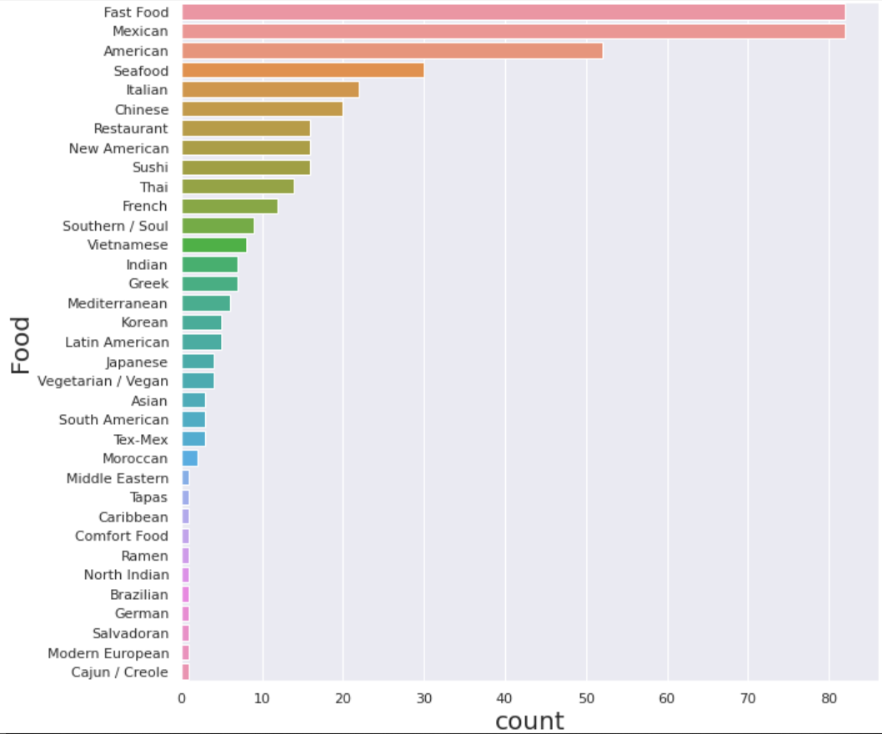
3.2 Data Overview
The number of unique venues in Dallas is 439.
The number of unique venue categories in Dallas is 35.
Chinese venues are listed as 6th in frequency.
The number of unique Chinese venues in Dallas 20.
Frequency of Restaurants in Dallas (top 11)

Slide 6
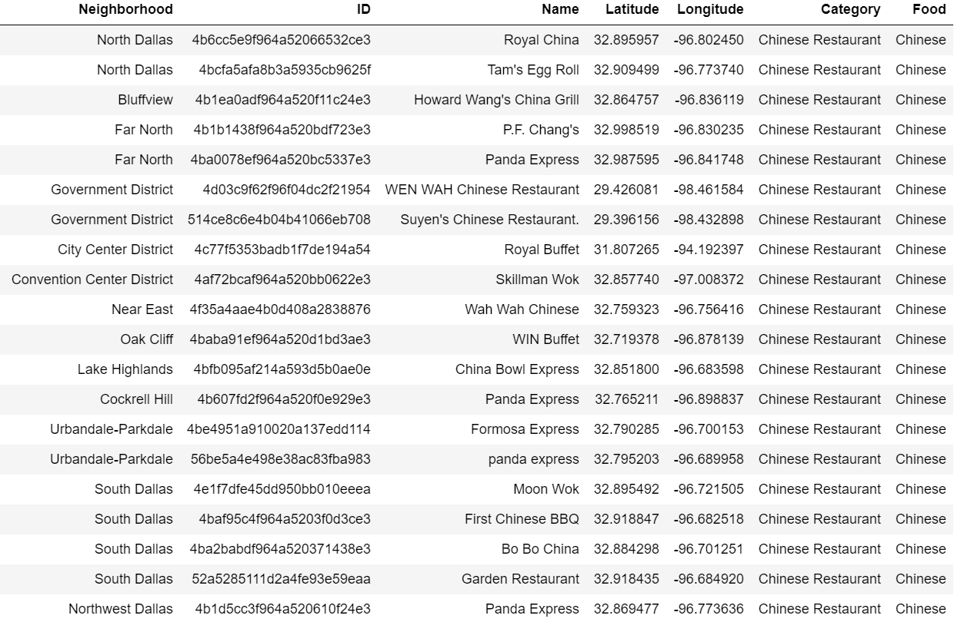
3.3 Data Analysis
As stated on the previous slide, the number of unique Chinese venues in Dallas 20. However, you must remember that our original business problem involves the lack of authentic Chinese restaurants. Below is the list of Chinese restaurants in the Dallas area, and I have lined through those that are automatically disqualified for our problem set (chain and fast food Chinese).
In this case, the removed restaurants were:
P.F. Chang’s
Panda Express (multiple)
“Buffet” style
“Express” style
This leaves us with 11 restaurants are a potentially “authentic,” but let's go back to look at the affluent neighborhoods.

Slide 7
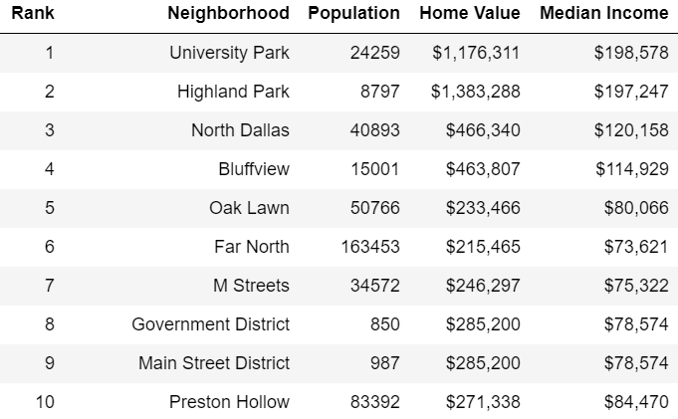
3.3 Data Analysis
The neighborhoods highlighted above are indicated to show that they have no Chinese restaurants whatsoever. The highlighted restaurants are to indicate those that do fall into affluent/”desirable” residential neighborhoods.

Slide 8
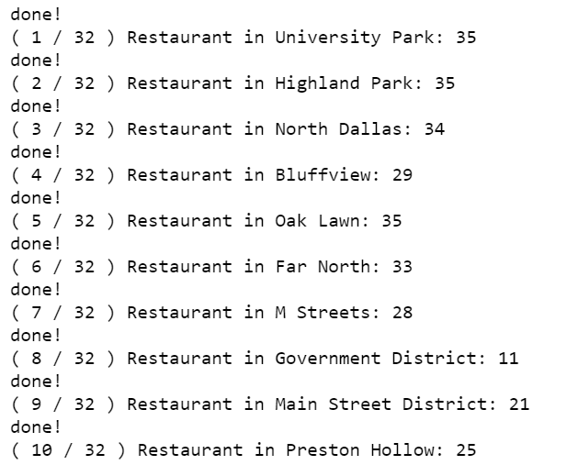
3.3 Data Analysis
Finally, the figures below show which neighborhoods (if any) are predominantly residential (there are no Chinese restaurants because there are no restaurants at all). As you can see, all affluent neighborhoods have at least a small number of restaurants in them.
All told, there are 212 restaurants in the highlighted neighborhoods, and none of them are Chinese, and they account for 48.3% of restaurants in Dallas.

Slide 9
4. Results
The data shows that most of the affluent neighborhoods in Dallas have no existing Chinese restaurants, but do have almost half the of existing restaurants within the city. Competition with other restaurants would be high, but competition with other Chinese restaurants would be virtually nonexistent. This indicates that these would be good areas to establish an authentic Chinese restaurant.

Slide 10
5. Discussion
It is observed that University Park, Highland Park, and Oak Lawn have a dense number of restaurants, but no Chinese restaurants. These neighborhoods are also 1st, 2nd, and 5th in terms of desirable/affluent locations to live in Dallas.
On the other hand, Mainstreet District and Preston Hollow (9th and 10th) have fewer restaurants, and therefore less competition overall.
Depending on stakeholder preference, my primary recommendation for opening a restaurant would be to locate in University Park.

Slide 11
5. Conclusion
In conclusion, 70% of the most affluent neighborhoods in Dallas are good candidates for establishing an authentic Chinese restaurant.
At this point I would take additional steps to answer the problem set to add context for the stakeholders. Research could be done to determine the type and disposition of existing Chinese restaurants in the area and types of restaurants in indicated areas, but that would branch outside of the toolset of this course.
Example: I would survey the quality of food being served based off personal experience. Normally pictures would be enough, but that’s because I specialize in Asian demographics.

Slide 12
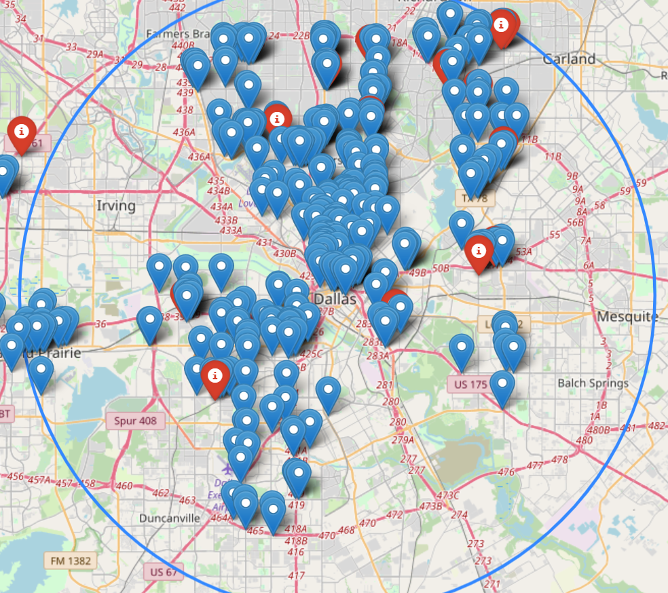
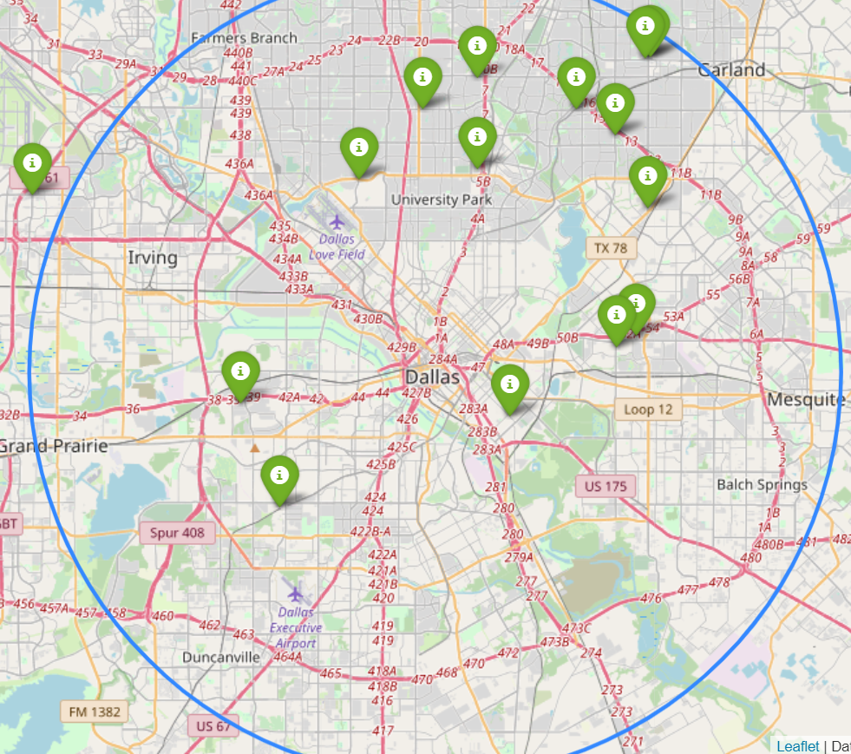
Reference: Restaurants in Dallas vs Chinese Restaurants in Dallas
Restaurants in Dallas
Chinese Restaurants in Dallas

Slide 13
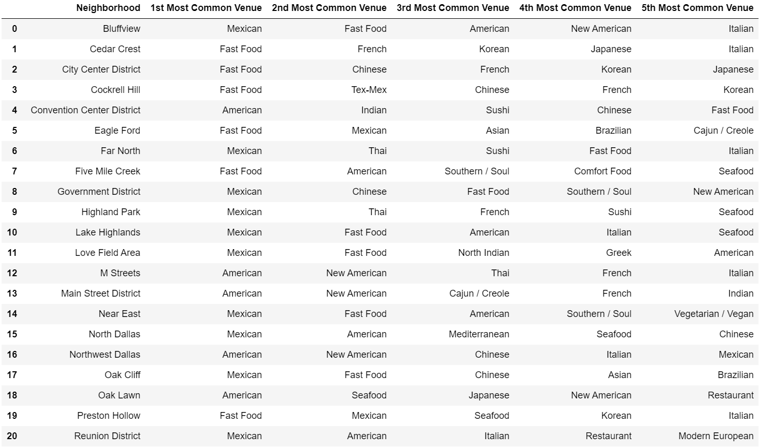
Most Common Restaurant Type in Dallas for 20 Neighborhoods (Alphabetical)

